Slide 1

FAKE NEWS DETECTION
USING PYTHON AND MACHINE LEARNING
Team PSA
1)Mohamed Aslam M
2)Prethisha V
3)Sahana K

Slide 2
Problem Statement
Project Overview
Importance of Fake News Detection
Usage of ML models for fake news
Data Preprocessing,Vectorization
Model Training,Working Model
Solution
Result
1
2
CONTENTS
3
4
5
6
7
8

Slide 3
1
Problem Statement

Slide 4

Problem Statement
To develop a machine learning model which can detect and classify fake news .The developed model should be applicable in real life scenarios

Slide 5
2
Project Overview

Slide 6
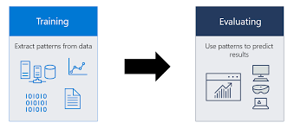
Project Overview
A machine learning model was constructed using python modules and was trained using fake news and true news datasets.Classfication algorithms such as Logistic Regression were implemented for fake news detection and Evaluation of model was performed using metrics such accuracy score,classification report and confusion matrix

Slide 7
3
Importance of Fake News Detection

Slide 8

Fake news detection is crucial in today's information age to preserve information integrity, protect democracy, mitigate social polarization, maintain trust in media and institutions, protect personal and public safety, and promote media literacy. Detecting and countering fake news requires a multi-faceted approach involving technology, media organizations, educational institutions, and individuals. Fact-checking organizations, improved algorithms, media literacy initiatives, and responsible reporting practices are key in enhancing fake news detection and minimizing its harmful effects..

Slide 9
4
Usage of ML models for Fake News Detection

Slide 10

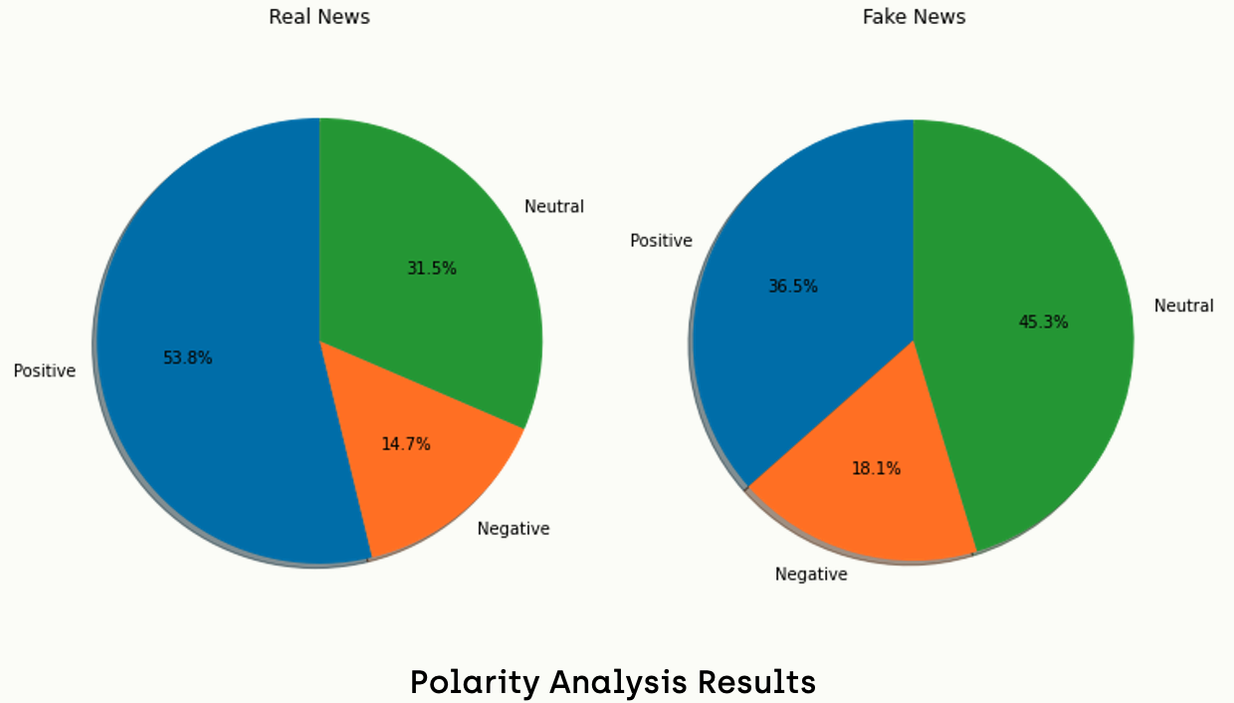

News can be fake or real.Fake news leads to spread of false information which can lead to negative events
Machine learning models are constructed by training on fake and real news
datasets
The model classifies the news to fake and real based on learning from training dataset

Slide 11
5
Data Preprocessing,Vectorization

Slide 12
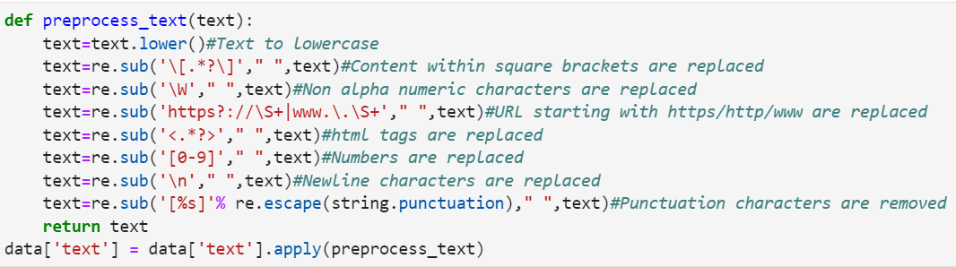
Data Preprocessing
The non alpha numeric characters,whitespaces,numbers ,punctuation marks which are not essential for fake news detection are removed from the text

Slide 13
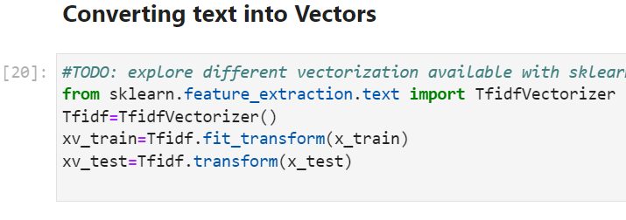
Vectorization
Words are translated to vectors so the ML model can understand and distuinguish different words
We use TF-IDF Vectorization which is a technique in NLP to represent text documents as numerical vectors. It considers the frequency of words in a document (term frequency) and their rarity across the document collection (inverse document frequency).

Slide 14
6
Model Training,Working Model

Slide 15
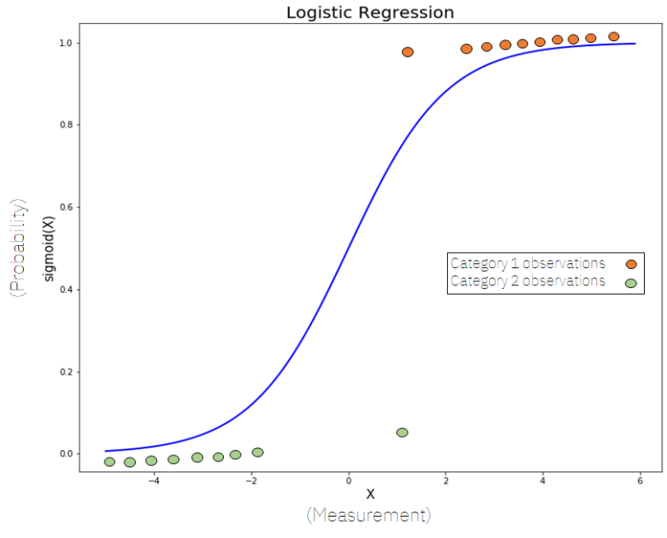
Model Training
Machine learning model is trained using vectorized training dataset and classification algorithm such as logistic regression was implemented for detecting fake news.
Logistic regression is a statistical model used for binary classification tasks, predicting the probability of an event belonging to one of two classes. It utilizes the sigmoid function to map features to probabilities between 0 and 1. The model is trained by optimizing coefficients through methods like maximum likelihood estimation or gradient descent.

Slide 16
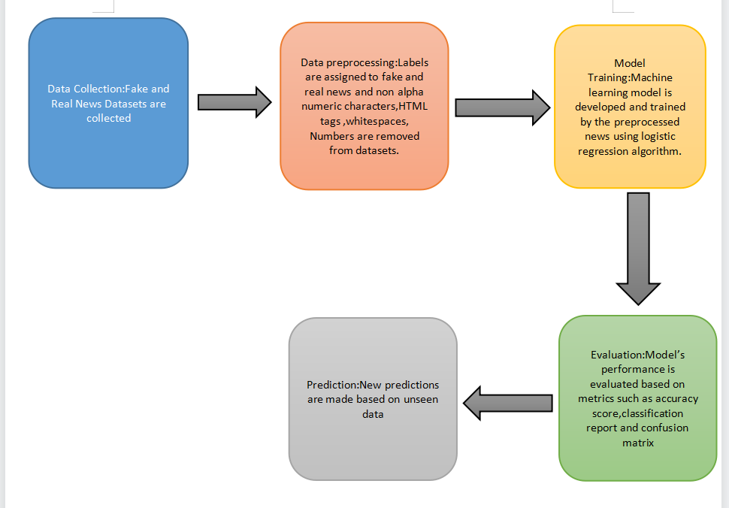
Working Model

Slide 17
7
Result

Slide 18
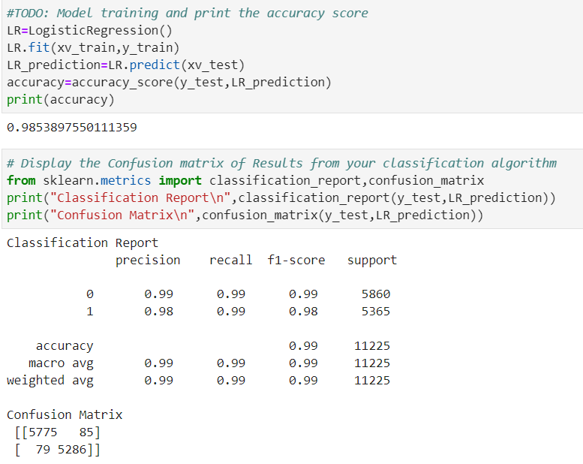
Solution
The model accuracy is 98.53%
Evaluation metrics such as classification reports,confusion matrix and accuracy score is used to verify the accuracy of detection of fake news of the model
A classification report summarizes the performance of a classification model with metrics like precision, recall, F1-score, and support for each class.
A confusion matrix is a table summarizing the performance of a classification model by showing true positives (TP), true negatives (TN), false positives (FP), and false negatives (FN). It helps evaluate the accuracy of the model and understand its error types.

Slide 19
8
Testing with external news

Slide 20

Testing the model with real life news

Slide 21
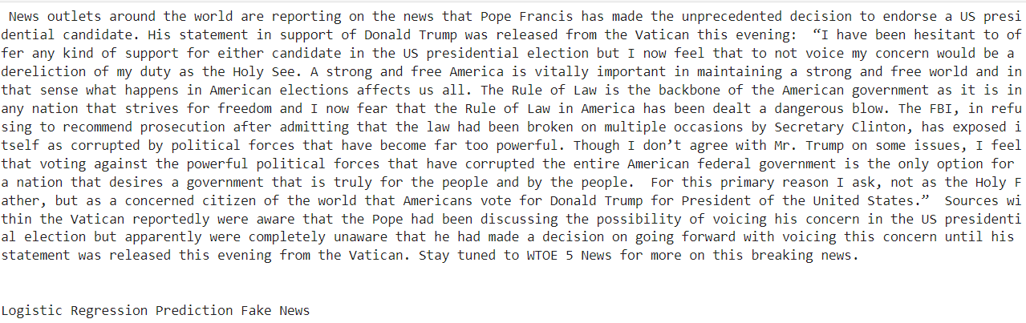
Testing the model with fake news

Slide 22
THANK YOU

